Slide 1
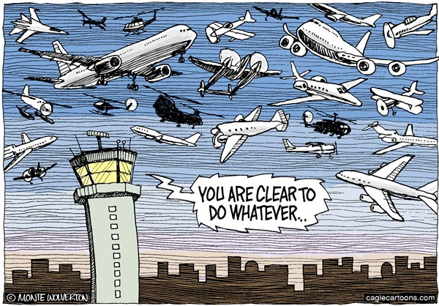

[Explained] Rules of the Air Implementation

Slide 2
Rule Engine Introduction
Rule Engine – configurable engine weaved into UTM, Mission Control, Avoidance Grid, Reach Set classes to enrich existing functionality.
Joint Point – point in process where rule engine is invoked,
Context – context passed to rule body
Rule – small piece of functionality
Rule Engine
Joint Point
Context
Rule

Slide 3
Rule Engine Architecture
Context
Gather
Context
Rule Engine
Invoke
Engine
Joint Point
Mission Control
Rule
Navigation Grid
My mission
Velocity Recalculation
Invoke Rule Instance
Parser
Check condition:
Intruder Velocity
Application
Parse context:
Intruder Position
Take action:
Slow down
Condition

Slide 4
Rule Engine in Nutshell
Benefits:
Modularity – keep rule specific code separated in one class with given condition and impact application, maintain separate functionality .
Scalability – use piece wise code in navigation/avoidance/control frameworks, activate/deactivate aspects and specific behaviors.
Rule chaining – rule can be invoked from Joint Point, or from other rule body, for example specific maneuver rule can be invoked from resolution rule, this becomes especially handy when aspects of logical programing are necessary.
Shortcomings:
Border Case Testing – needs to be implemented to verify rule functionality as intended, the test conditions are hard to assume.
Configurability Bias – is induced at change of configuration.

Slide 5
Rule Engine Setup
0..*
0..*
0..*
Context
Joint Point
Rule
Mission Control
Before Avoidance Run
Detect Collision Cases
After Avoidance Run
Close Collision Cases
Navigation Grid
Trajectory Restriction
Resolve Collision Cases
Invoke based on:
Avoidance role
Converging Maneuver
Overtake
Head On Approach
Right Plane Heading
Forced invoke:
Enforce Safety Margin

Slide 6
Rule: Right Plane Heading
Collision Zone: For given vehicle position and collision point there exist a space division by plane defined between points parallel with Z axis. The separation divides operation space into:
Collision zone – all points on left from vehicle viewpoint,
Free zone – all points on the right form vehicle viewpoint.
Objective: Disable trajectories which are:
Heading into Collision zone,
Leading into Collision zone.
[o] Collision Point [-] Enabled Trajectories [ ] Reachable cells
[-] Separation Line [-] Disabled trajectories [ ] Unreachable cells
Context | Condition | Application
UAS Navigation Grid Collision Point (LOC) | There are feasible trajectories | Disable trajectories of Navigation grid

Slide 7
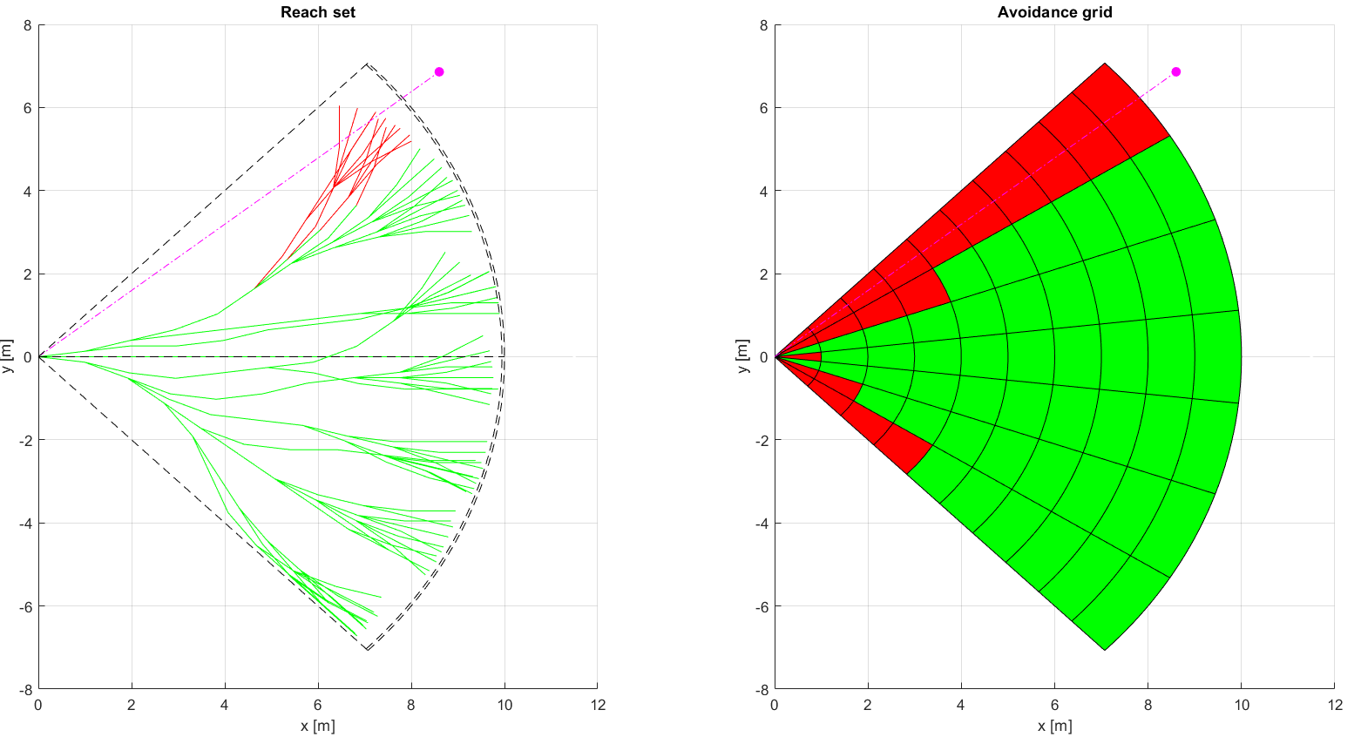
Right Plane Heading (1)

Slide 8
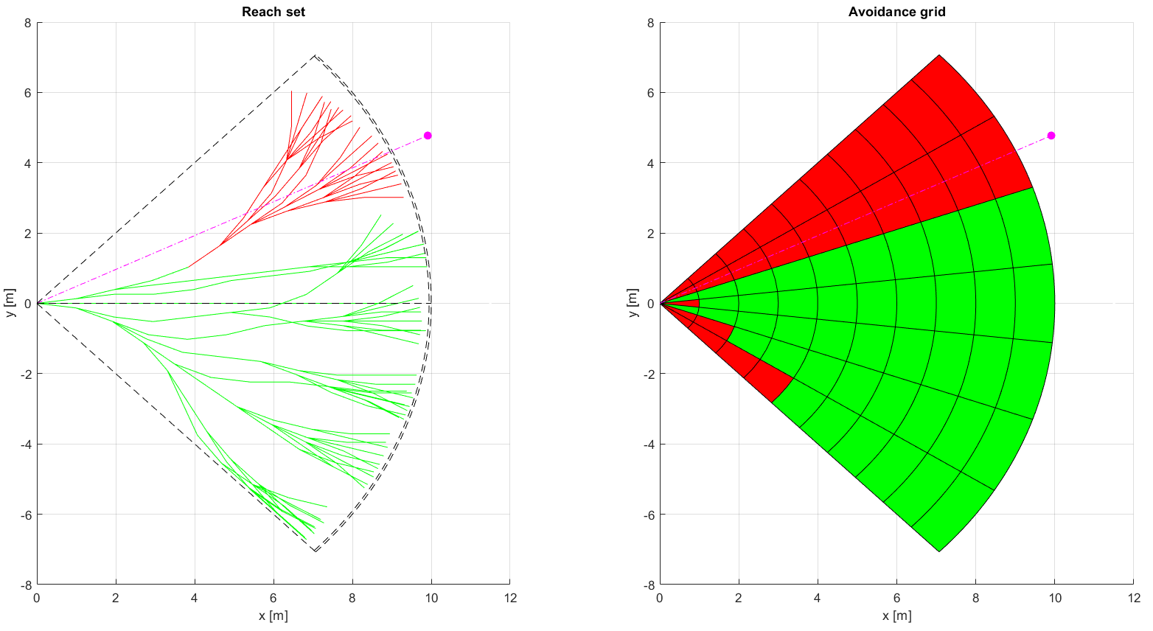
Right Plane Heading (2)

Slide 9
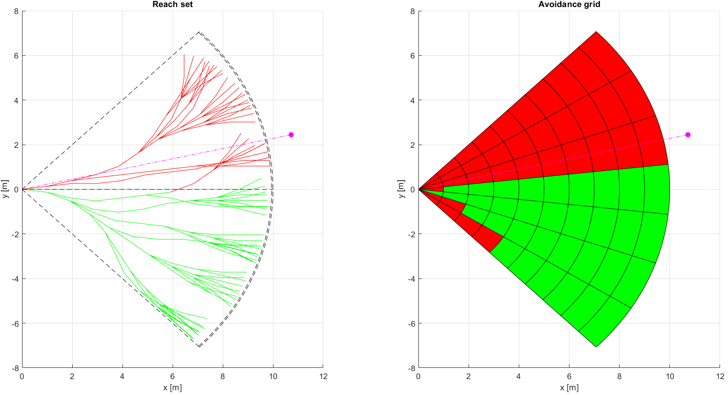
Right Plane Heading (3)

Slide 10
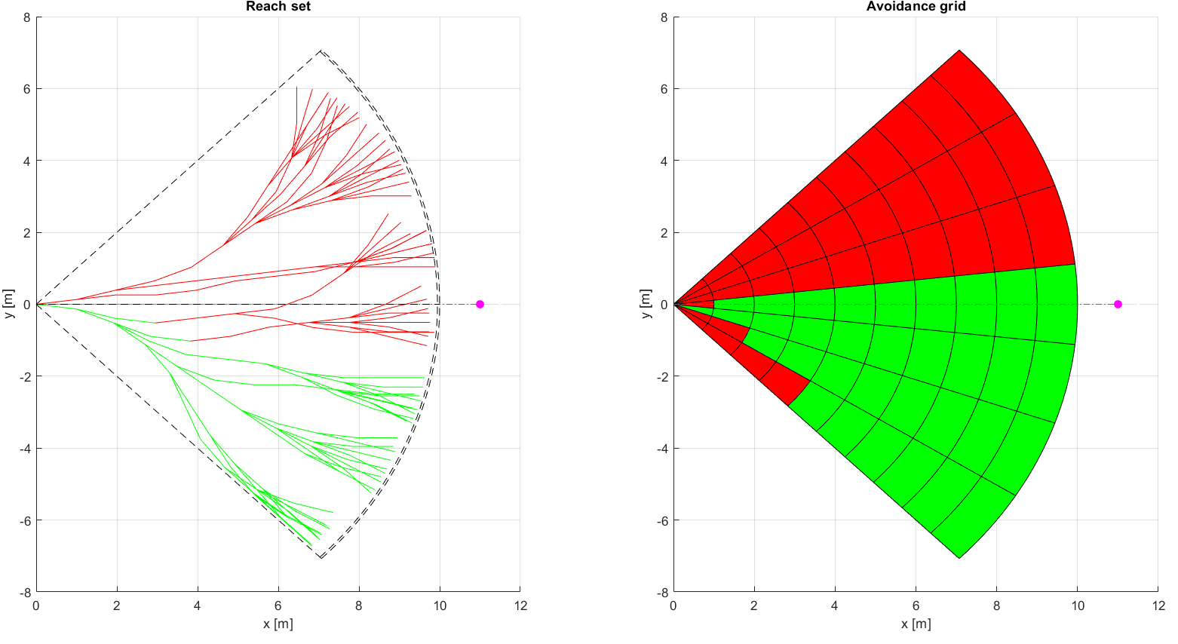
Right Plane Heading (4)

Slide 11
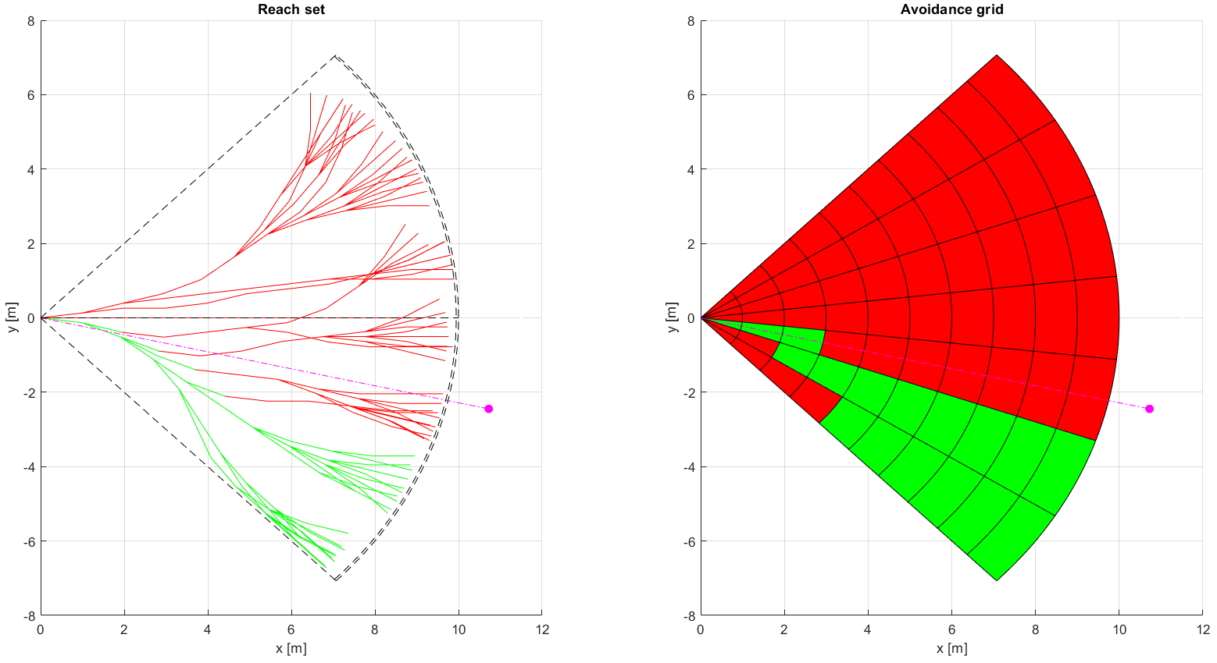
Right Plane Heading (5)

Slide 12
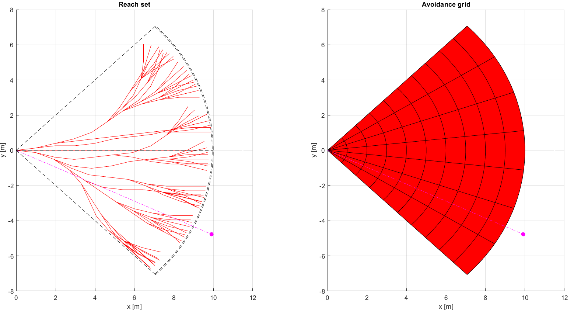
Right Plane Heading (6)

Slide 13

Disable Left Plane Heading (7)

Slide 14
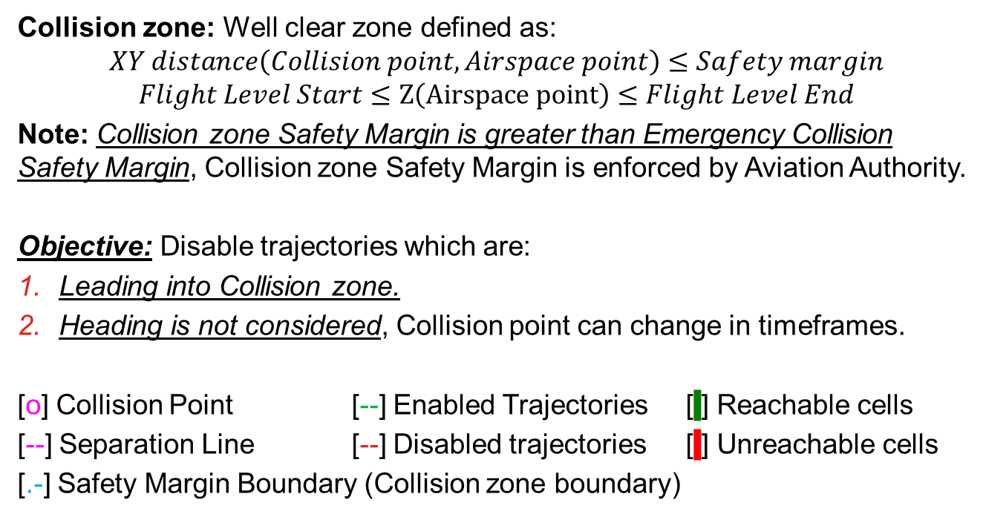
Rule: Enforce Safety Margin
Collision zone: Well clear zone defined as:
$$XY distance\left(Collision point, Airspace point\right)≤Safety margin$$
$$Flight Level Start≤Z\left(Airspace point\right)≤Flight Level End$$
Note: Collision zone Safety Margin is greater than Emergency Collision Safety Margin, Collision zone Safety Margin is enforced by Aviation Authority.
Objective: Disable trajectories which are:
Leading into Collision zone.
Heading is not considered, Collision point can change in timeframes.
[o] Collision Point [--] Enabled Trajectories [ ] Reachable cells
[--] Separation Line [--] Disabled trajectories [ ] Unreachable cells
[.-] Safety Margin Boundary (Collision zone boundary)
Context | Condition | Application
UAS Navigation Grid Collision Point (LOC) | There are feasible trajectories | Disable trajectories of Navigation grid

Slide 15
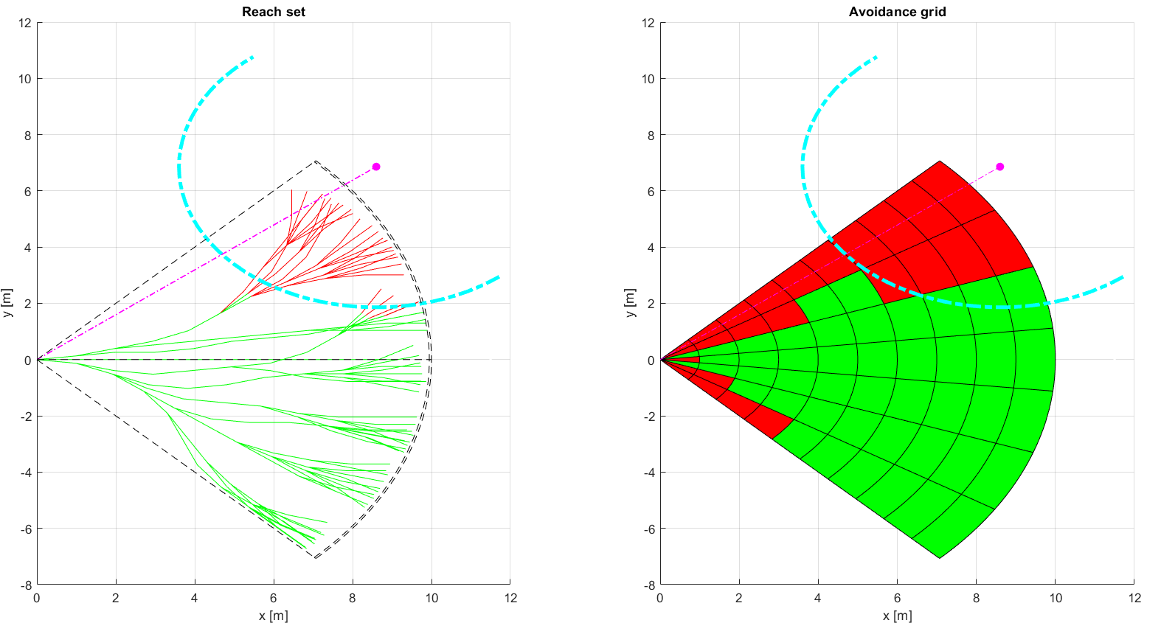
Enforce Safety Margin (1)

Slide 16
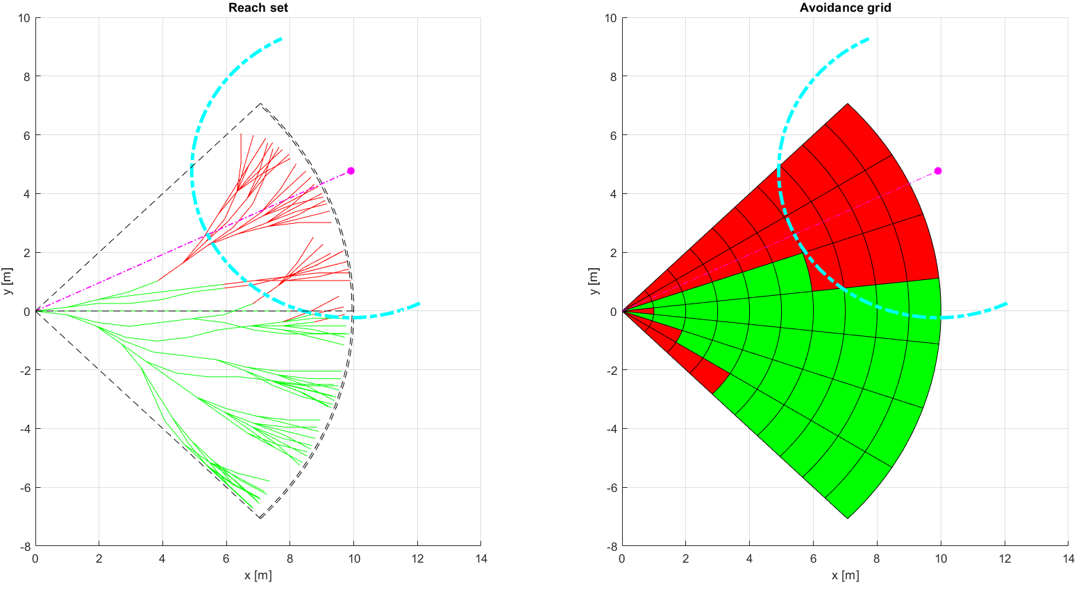
Enforce Safety Margin (2)

Slide 17
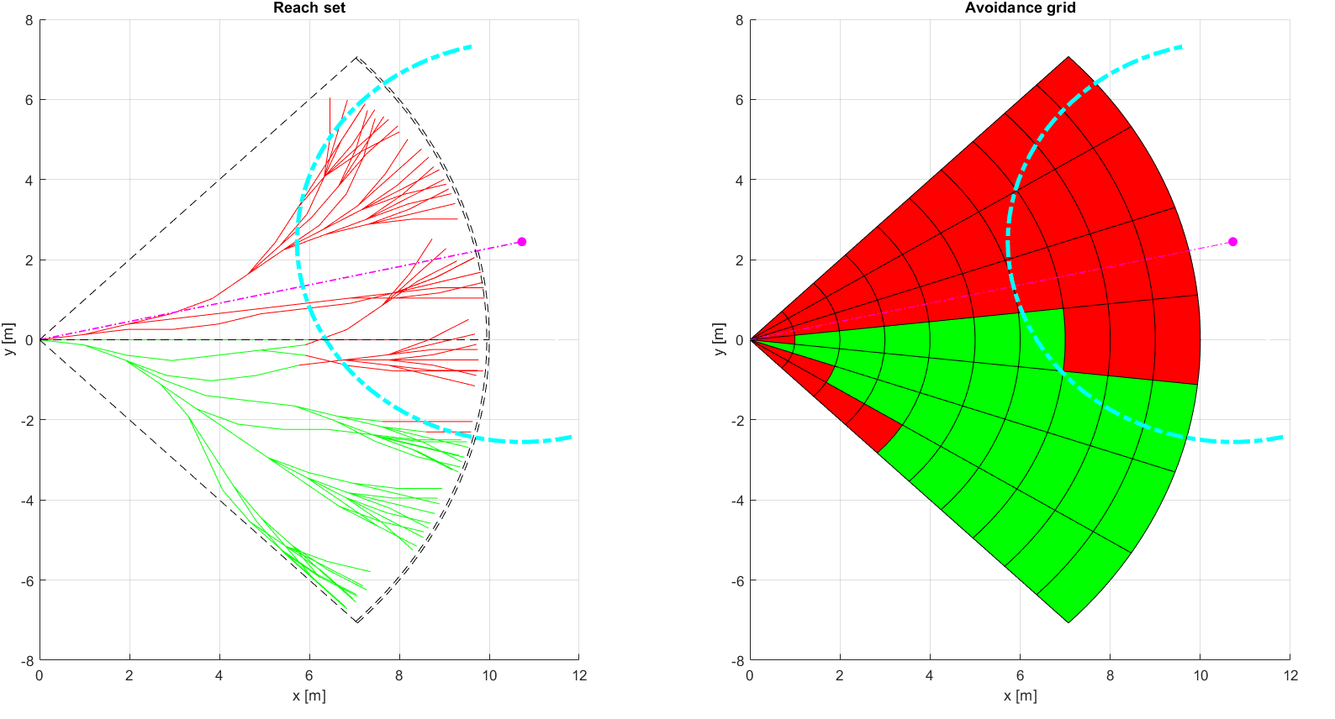
Enforce Safety Margin (3)

Slide 18
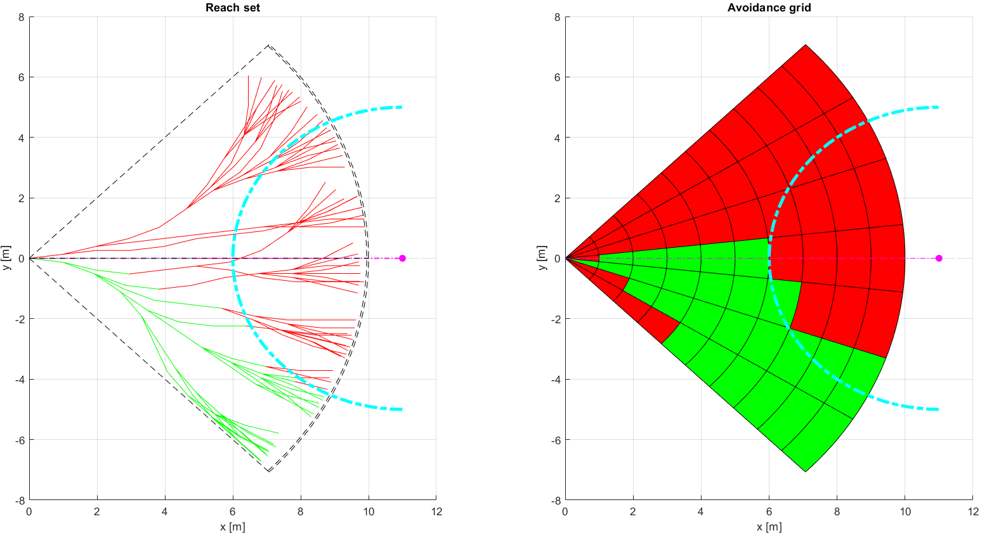
Enforce Safety Margin (4)

Slide 19
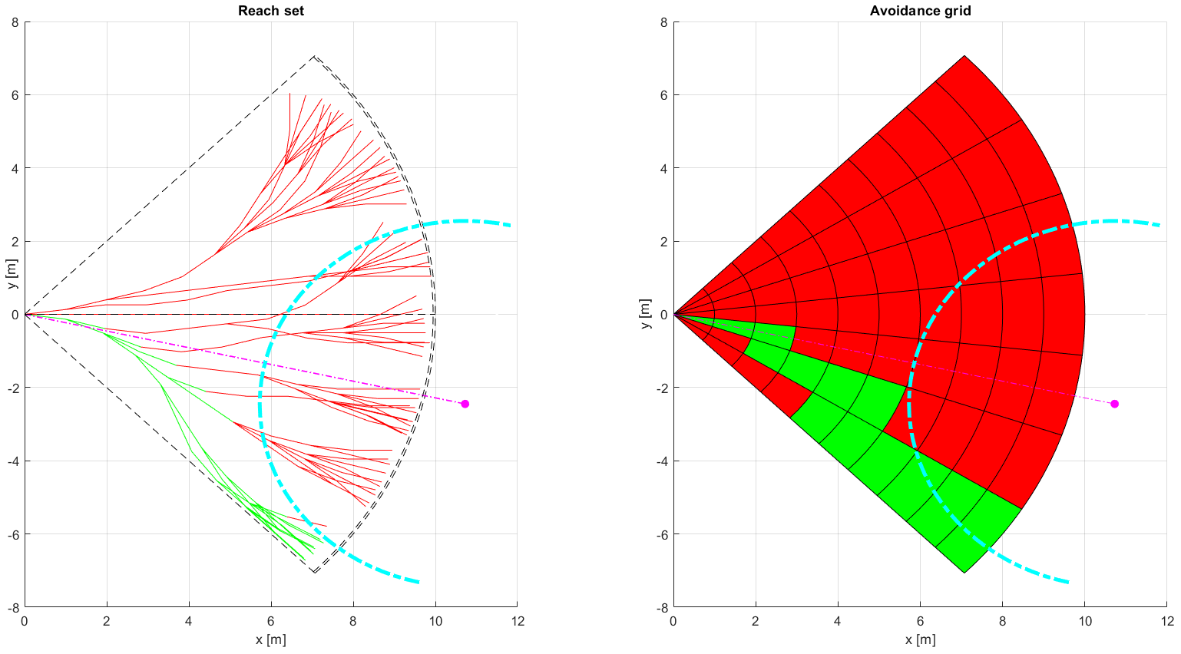
Enforce Safety Margin (5)

Slide 20
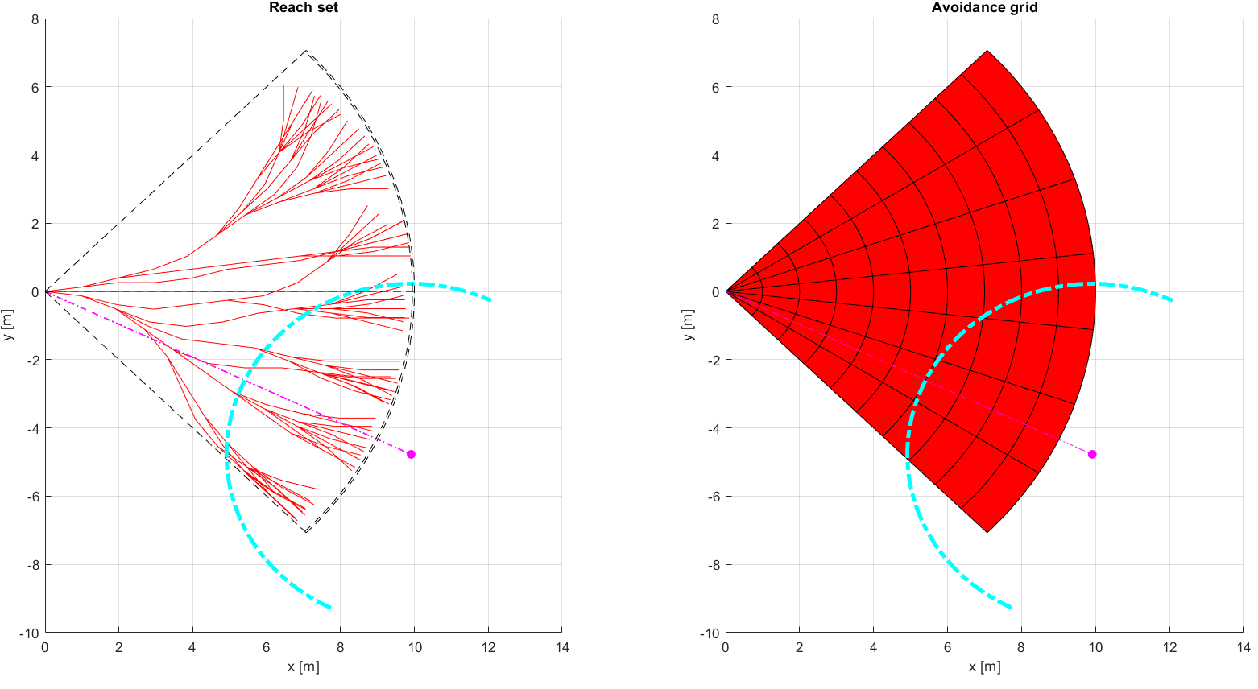
Enforce Safety Margin (6)

Slide 21
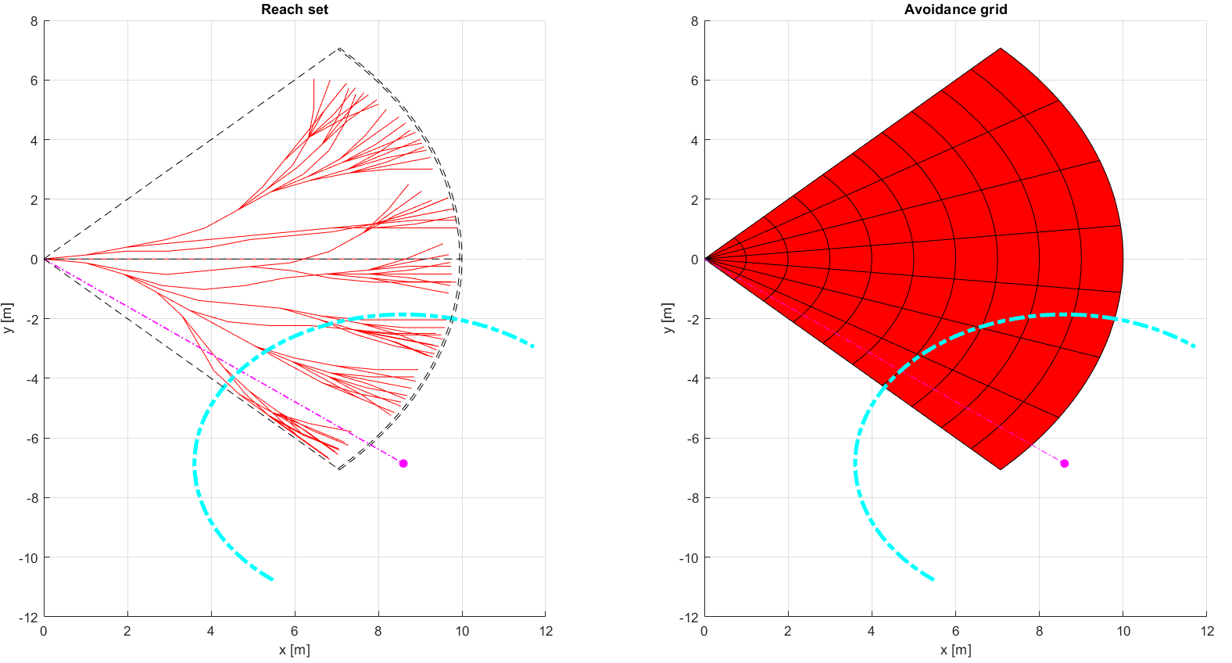
Enforce Safety Margin (7)

Slide 22
Rule: Detect Collision Cases
Invocation: Every Decision Point in UAS main navigation loop.
Objective: Prepare Collision Cases for evasive maneuvers application
Fetch UTM Collision Cases for given timeframe,
Create/Update own Collision Cases for given timeframe,
Merge Collision cases based on source priority order,
Select Active Collision Cases based on following conditions:
Active participation in collision case => avoidanceRole ~= Right of the Way,
Collision Point is in front of vehicle,
Emergency mode of all Collision Case participants is INACTIVE.
Order Collision Cases based on SEVERENITY (descending),
If there is at least one active collision case enforce inner Avoidance Run.
Context | Condition | Application
UAS Mission Control Before Avoidance Run, UTM/UAS Col. Cases | Clean Avoidance Grid, No higher Avoidance priority, | Active Collision Cases selection, Prioritization

Slide 23
Rule: Resolve Collision Case
Invocation: This rule is invoked only if there is any active Collision Case in given Navigation Grid timeframe, moreover Avoidance Grid should be empty.
Objective: Based on own calculated collision cases and UTM directives (has higher priority):
Fetch Active Collision Cases(Avoidance Role, Collision Point)
Enforce Rules based on Avoidance Role and Collision Point as:
Converging Maneuver – invoke Rule: Converging Maneuver
Head On approach – invoke Rule: Head On Approach
Overtake – invoke Rule: Overtake
Emergency Maneuver – register intruder object into UAS Mission Control
Context | Condition | Application
UAS Mission Control, Trajectory restriction, Collision Cases | Active UTM collision Case, Resolution mandate for UAV | Enforce Rules of Air OR Enforce Emergency

Slide 24
Rule: Close Collision Case
Invocation: There exists at least one Active Collision Case.
Objective: Ensure that multiple Avoidance Rules application gives feasible Avoidance Strategy, otherwise enter EMERGENCY MODE,
Collect rules applied on Navigation Grid from Active Collision Cases,
Calculate possible routes for Avoidance (there may be none),
If there is no Active Route: For each Intruder:
Issue warning message to containing expected Collision Point, and, Preferred Separation Type,
Create Intruder objects for Avoidance Grid
Calculate Evasive Maneuver based on Expected Separation.
Notify UTM about Collision Case Resolutions.
Notify UTM with Planned Trajectory and Avoidance Mode
Context | Condition | Application
UAS Mission Control, After Avoidance Run, Collision Resolutions | At least one route in Navigation Grid, Emergency check | Force Emergency Mode OR Close Collision Cases

Slide 25
Rule: Converging Maneuver
Invocation: When role of UAS is Converging and Avoidance Grid is Empty
Objective: Ensure that UAS will not enter into Intruder “Well clear” barell.
Prevent Left-Side Maneuvers
Prevent Converging Safety Margin Breach
Return to original Path
Prevent Wake turbulence.
Context | Condition | Application
UAS Navigation Grid Collision Point, Avoidance Role | None | RunRules: Right Plane Heading Enforce S. Margin

Slide 26
Rule: Head On Approach
Invocation: When role of UAS is Converging and Avoidance Grid is Empty
Objective: Ensure that UAS will not enter into Intruder “Well clear” barbell.
Prevent Left-Side Maneuvers,
Prevent Converging Safety Margin Breach,
Return to original Path,
Prevent Wake turbulence,
Enforce Round-about behavior,
Context | Condition | Application
UAS Navigation Grid Collision Point, Avoidance Role | None | Run rules: Right Plane Heading Enforce S. Margin

Slide 27
Rule: Overtake
Invocation: Invoked by rule Collision Case Resolution.
Divergence Waypoint: waypoint to diverge from original UAS path to ensure Intruder safety, within unchanged intruder velocity and heading.
Convergence Waypoint: waypoint when convergence to original UAS path is enabled, within unchanged intruder velocity and heading.
Objective:
Calculate Divergence Waypoint
Calculate Convergence Waypoint
Enforce Divergence/Convergence waypoint
Context | Condition | Application
UAS Navigation Grid Collision Point, Avoidance Role, | UAS Velocity >>>> Intruder Velocity | Calculate: Divergence WP Convergence WP

Slide 28
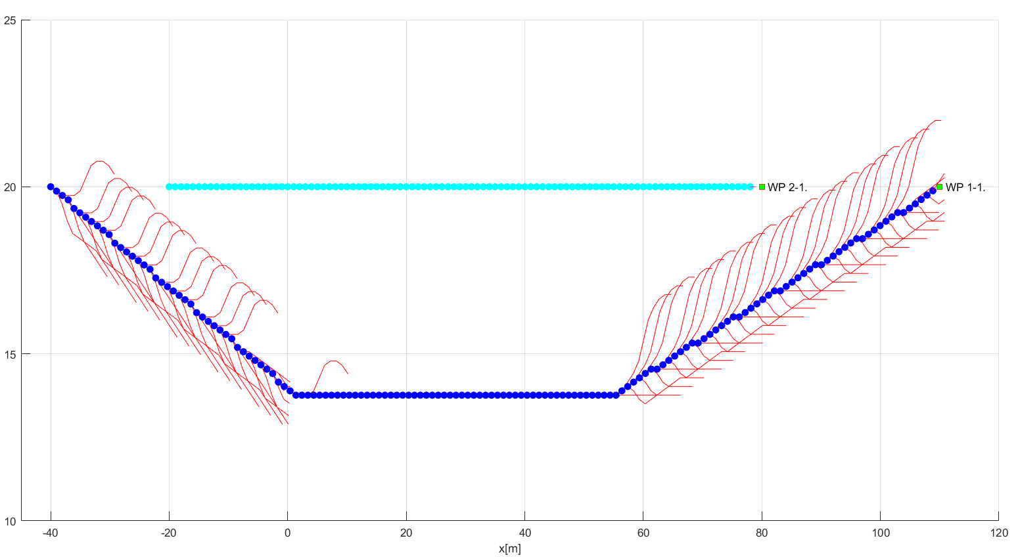
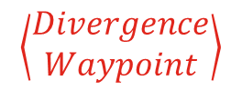
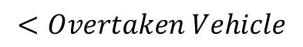
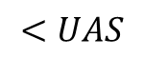
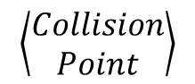
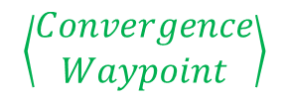
Divergence/Convergence Waypoint Example
$$\left\langle \begin{aligned}Collision \\ Point\end{aligned}\right\rangle$$
$$<UAS$$
$$<Overtaken Vehicle$$
$$\left\langle \begin{aligned}Divergence \\ Waypoint\end{aligned}\right\rangle$$
$$\left\langle \begin{aligned}Convergence \\ Waypoint\end{aligned}\right\rangle$$

Slide 29
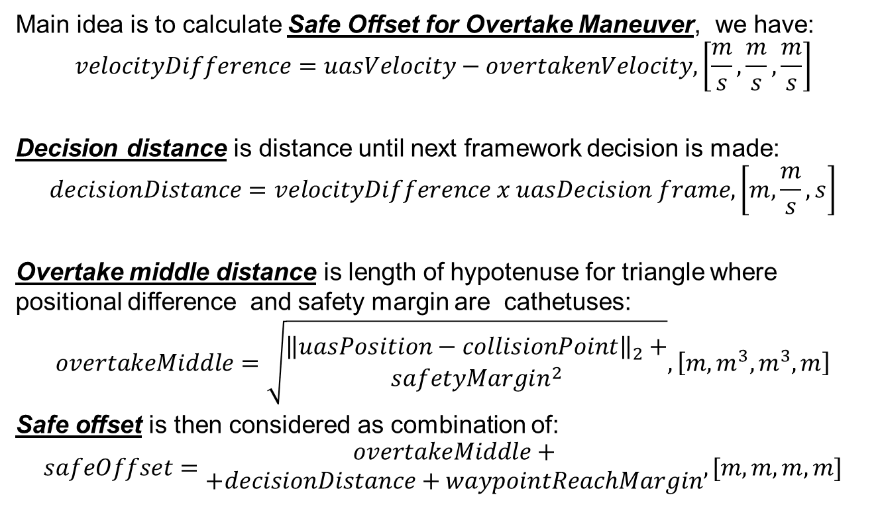
Divergence/Convergence Waypoint Calculation
Main idea is to calculate Safe Offset for Overtake Maneuver, we have:
$$velocityDifference=uasVelocity−overtakenVelocity, \left[\frac{m}{s},\frac{m}{s},\frac{m}{s}\right]$$
Decision distance is distance until next framework decision is made:
$$decisionDistance=velocityDifference x uasDecision frame, \left[m,\frac{m}{s},s\right]$$
Overtake middle distance is length of hypotenuse for triangle where positional difference and safety margin are cathetuses:
$$overtakeMiddle=\sqrt{\begin{matrix}{\left\|uasPosition−collisionPoint\right\|}_{2}+ \\ safetyMargin^{2}\end{matrix}}, \left[m,m^{3},m^{3},m\right]$$
Safe offset is then considered as combination of:
$$safeOffset=\begin{matrix}overtakeMiddle+ \\ +decisionDistance+waypointReachMargin\end{matrix}, [m,m,m,m]$$

Slide 30
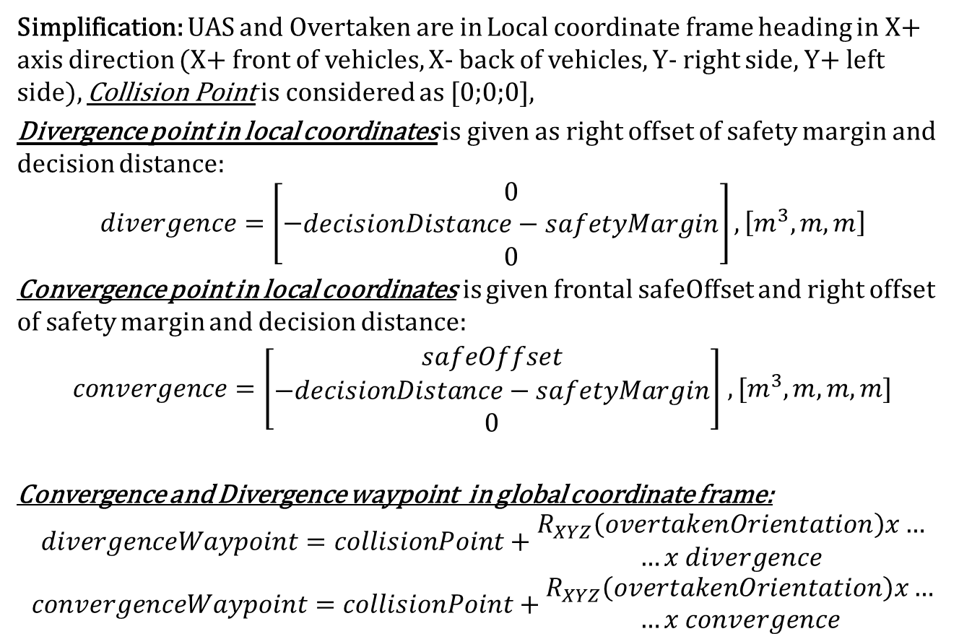
Divergence/Convergence Waypoint Calculation
Simplification: UAS and Overtaken are in Local coordinate frame heading in X+ axis direction (X+ front of vehicles, X- back of vehicles, Y- right side, Y+ left side), Collision Point is considered as [0;0;0],
Divergence point in local coordinates is given as right offset of safety margin and decision distance:
$$divergence=\left[−\begin{matrix}0 \\ decisionDistance−safetyMargin \\ 0\end{matrix}\right],\left[m^{3},m,m\right]$$
Convergence point in local coordinates is given frontal safeOffset and right offset of safety margin and decision distance:
$convergence=\left[\begin{matrix}safeOffset \\ −decisionDistance−safetyMargin \\ 0\end{matrix}\right]$ $,[m^{3},m,m,m]$
Convergence and Divergence waypoint in global coordinate frame:
$$divergenceWaypoint=collisionPoint+\begin{matrix}R_{XYZ}\left(overtakenOrientation\right)x… \\ …x divergence\end{matrix}$$
$$convergenceWaypoint=collisionPoint+\begin{matrix}R_{XYZ}\left(overtakenOrientation\right)x… \\ …x convergence\end{matrix}$$

Slide 31
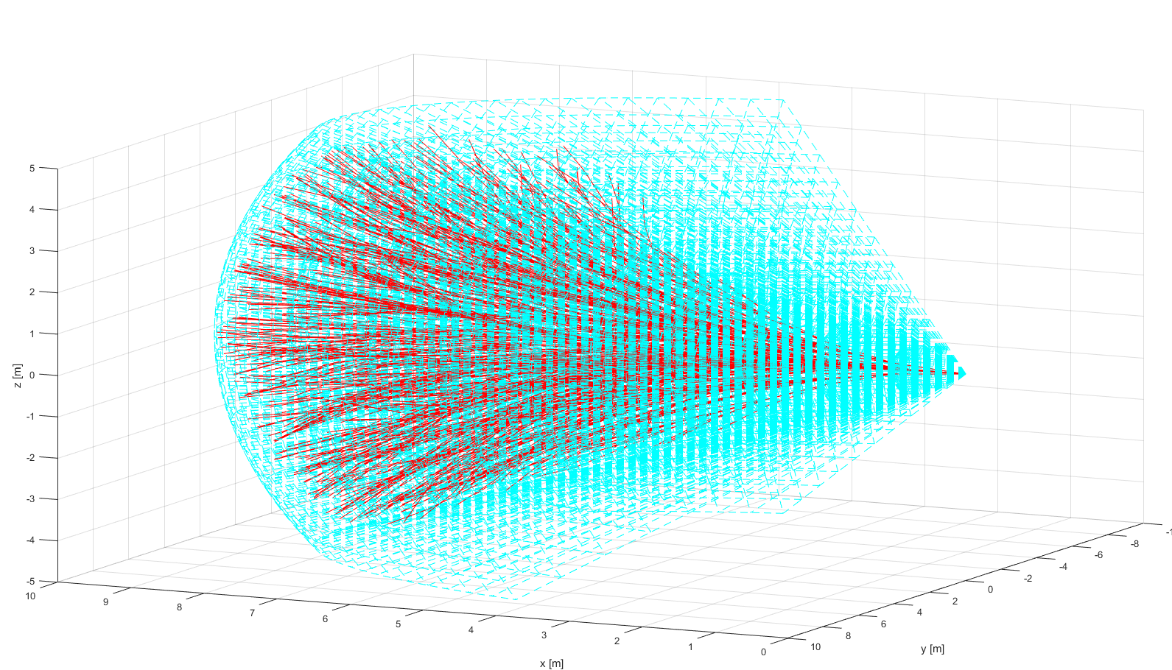
ACAS-XU Reach Set

Slide 32
ACAS-XU functionality as Reach Set
The Standard Controlled Airspace provides horizontal and vertical separation functionality, the separation in manned aviation is secured by TCAS I/II systems which issues Traffic Alerts and recommends Directional Changes Advices.
Next generation separation system family ACAS-X (in development) can issue Traffic Commands, taking Unmanned Aviation into account, the special framework ACAS-XU is dedicated for UAS systems (autonomous drones).
The ACAS-XU provides following separations:
Standard Separations – inherited from TCAS II and Other ACAS-X systems.
Combined Separations – native for ACAS-XU systems.
Restricted Reach Set estimation method is presented for following reasons:
Increase Framework variability and provide functionality for ACAS-XU
Prove that framework is independed on used Reach Set Estimation method

Slide 33
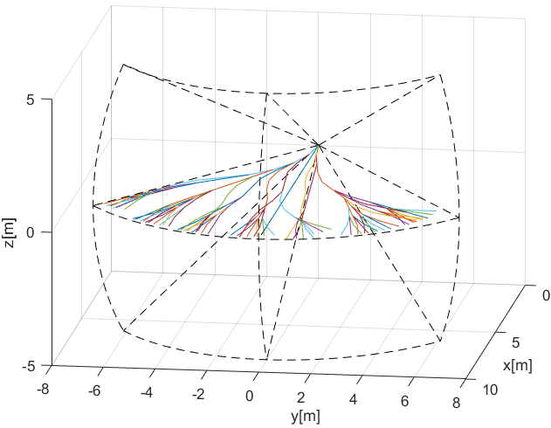
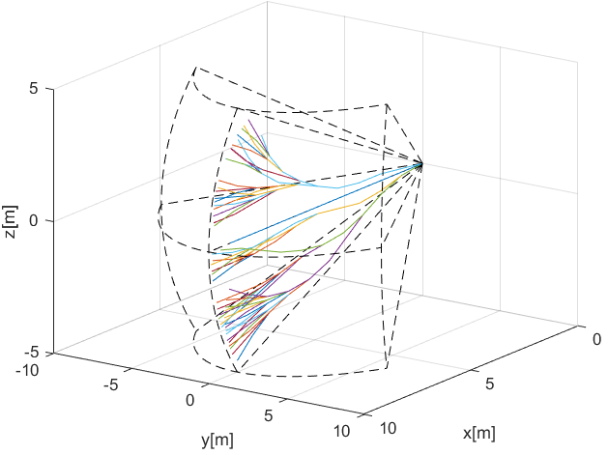
Standard Separations
Standard Separations are supported in other ACAS-X implementations as maneuver look-up tables, the trajectories are slightly diverged right (horizontal) and down (vertical) for support of standard TCAS II behavior and Rules of the Air implementation.
Horizontal Separation – standard separation in Flight Level area regardless of the altitude, horizontal separation would not break flight level therefore is preferred for conflict resolution.
Vertical separation – separation for aircrafts with better horizontal maneuverability.

Slide 34
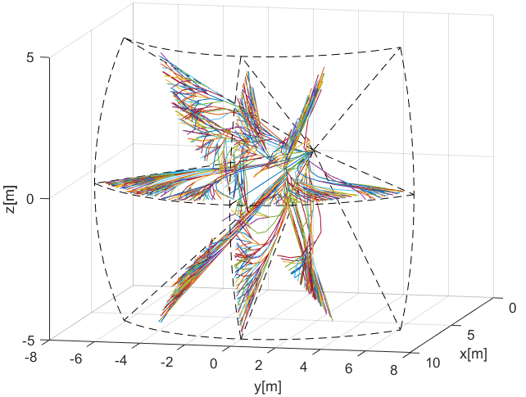
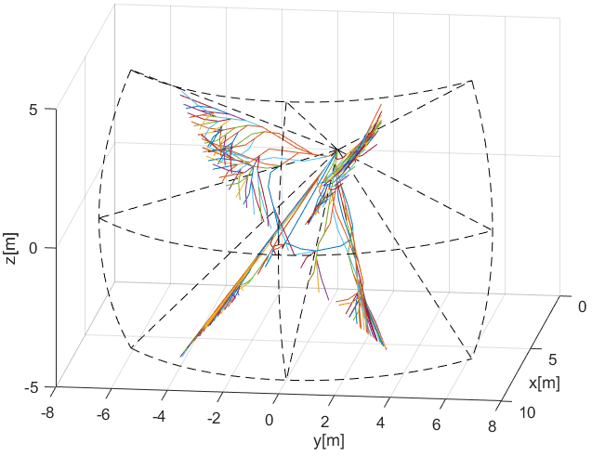
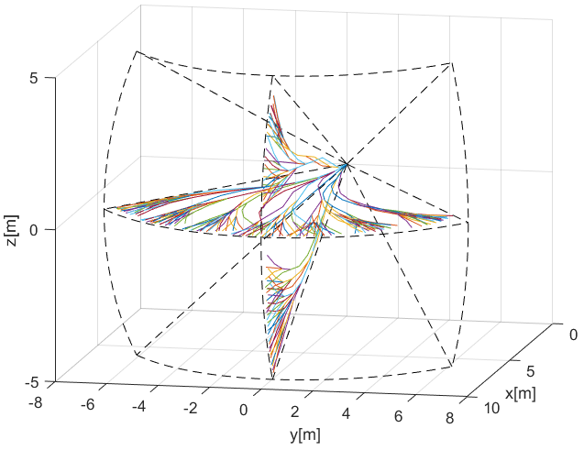
Combined Separations
Complete separations – containing horizontal vertical and tilted separations, closest to original Harmonic Reach set.
Horizontal/Vertical – containing horizontal and vertical separations, close to original TCAS II.
Tilted Left/Tilted Right – ACAS-XU

